Slide 1
Compilers VS Interpreters
6/23/2024
Zay Min Paing

Slide 2
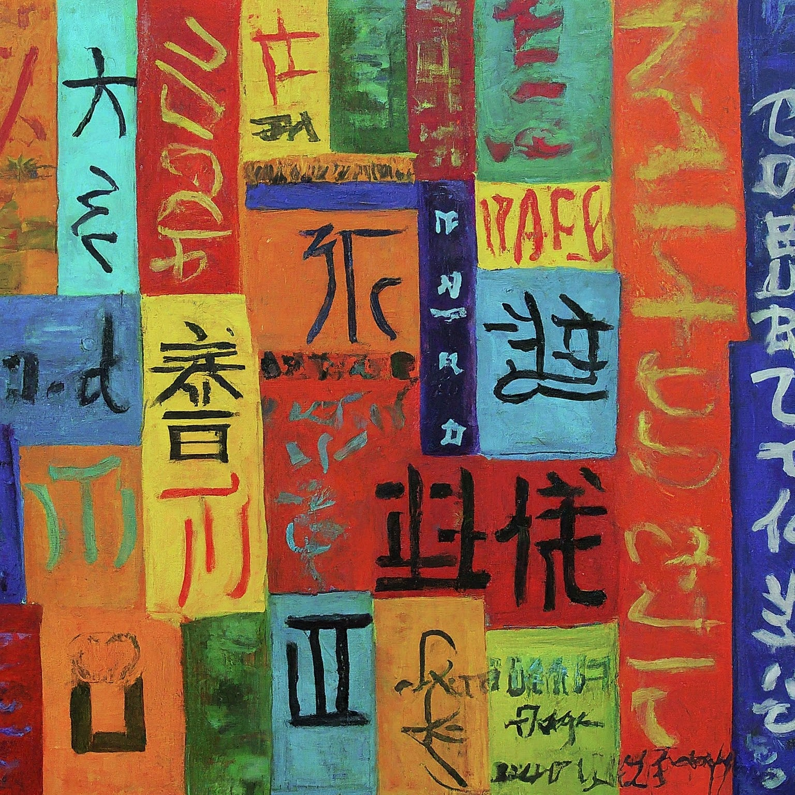
We speak several different languages
English
Chinese
Burmese
Jinghpaw
Japanese
Karen

Slide 3
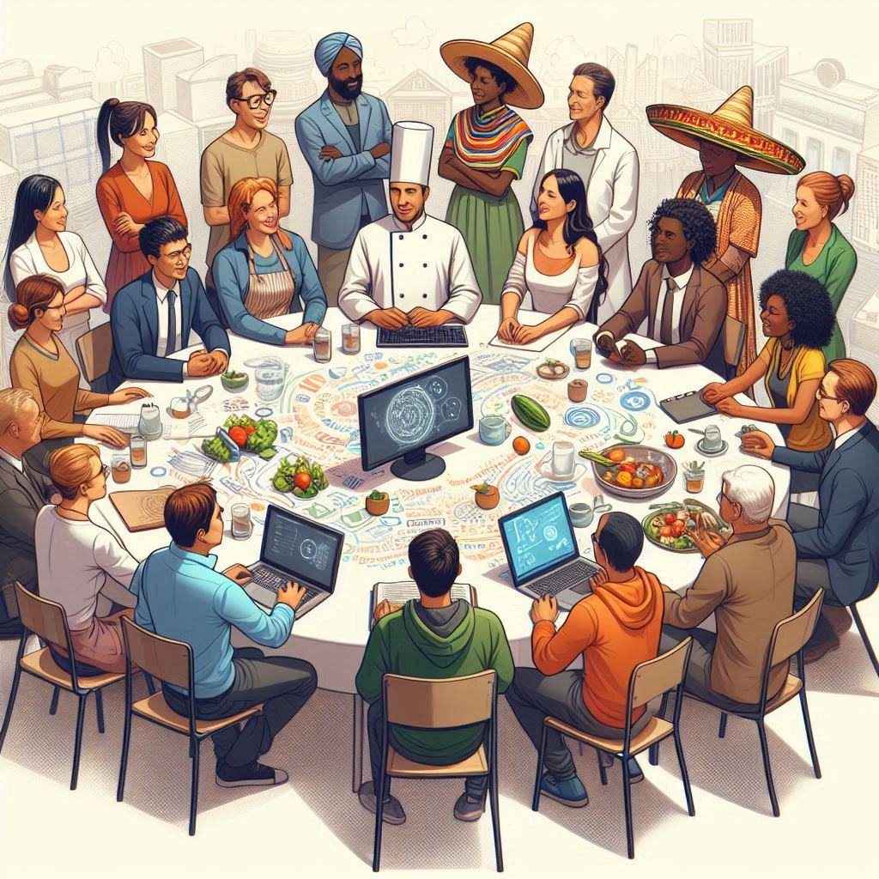
Computers do not understand any of the human languages
?

Slide 4
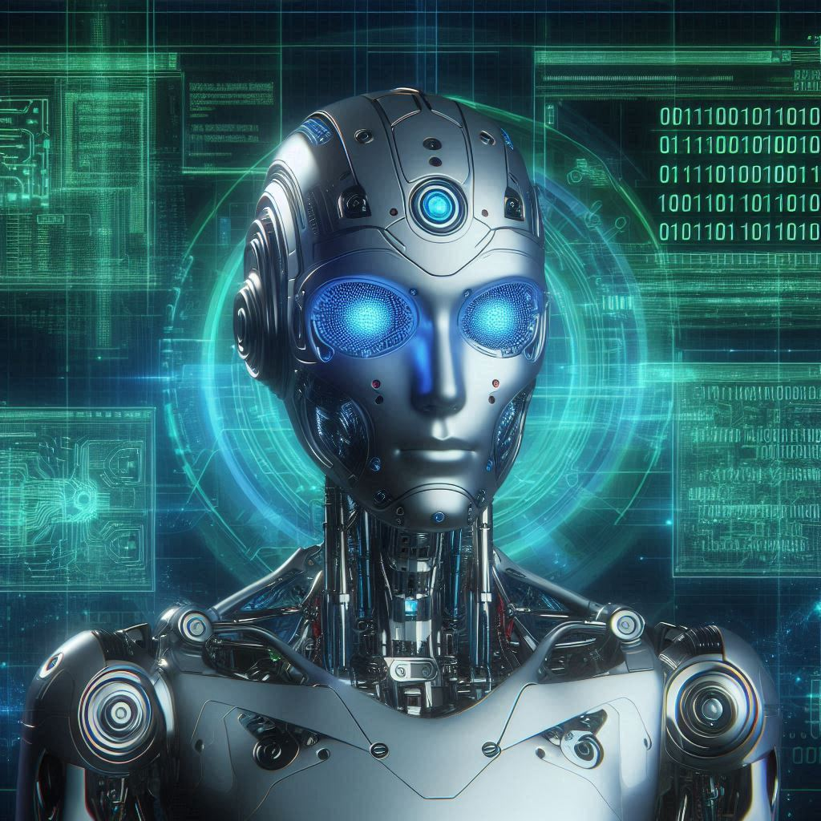
What do computers understand?
Computers understand only the machine code which contains only 0s and 1s.

Slide 5
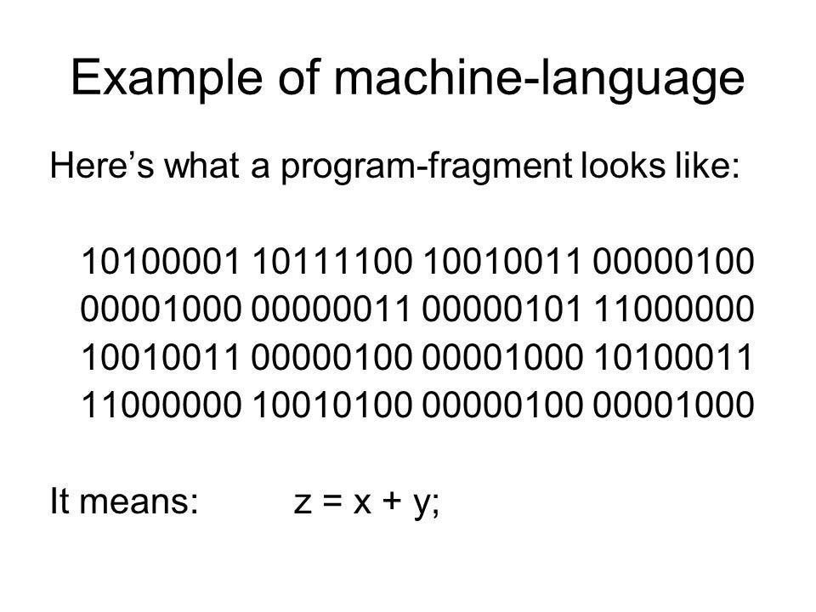

Machine code is too difficult for us to understand

Slide 6
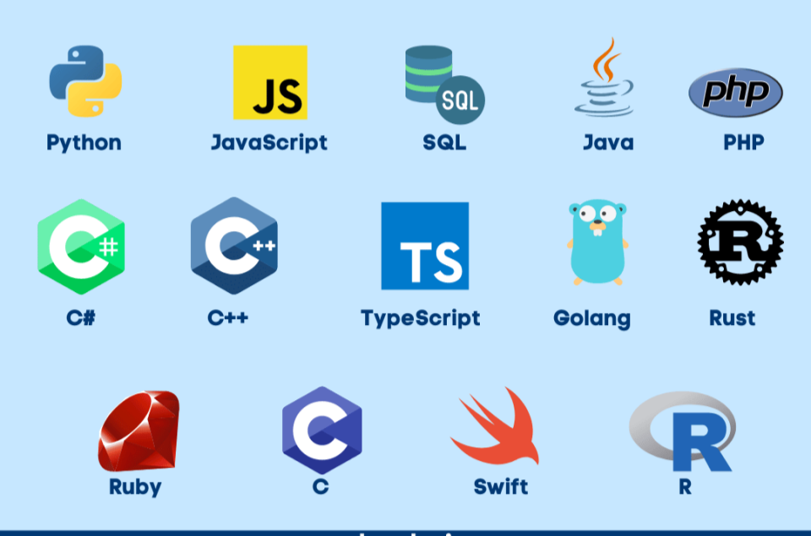
We use programming languages instead of machine code to give computers instructions

Slide 7
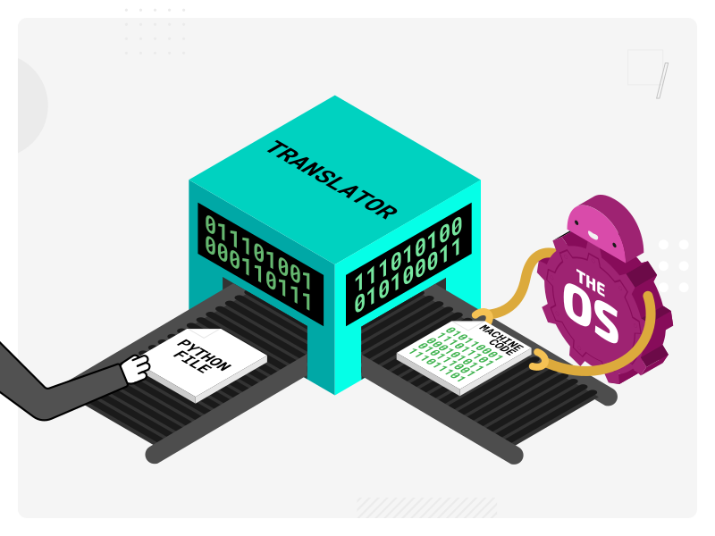
Compilers and interpreters serve as translators

Slide 8
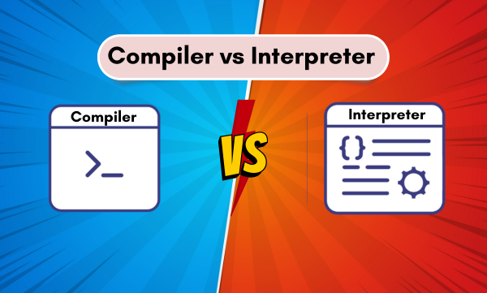
What is the difference?

Slide 9


There are two waiters in a restaurant
Aung Aung
Kyaw Kyaw

Slide 10
If the customer orders spaghetti, salad & steak
Takes all the orders for spaghetti, salad & steak
Sends them to the chef
Delivers all the meals to the customer in one go
Aung Aung

Slide 11
If the customer orders spaghetti, salad & steak
Takes the order for the spaghetti
Sends it to the chef
Delivers the spaghetti to the customer
Then moves on to taking the order for the salad, sends it to the chef and delivers the salad to the customer
Continues in this manner for each meal ordered
Kyaw Kyaw

Slide 12
Compilers VS Interpreters
Compiler
Interpreter

Slide 13
Compilers VS Interpreters
Compilers
Interpreters
Translate all the code written in a programming language into the machine code in one go
Execute them
Translate one instruction written in a programming language into the machine code
Execute the instruction
Translate another instruction written in a programming language into the machine code and so on...

Slide 14
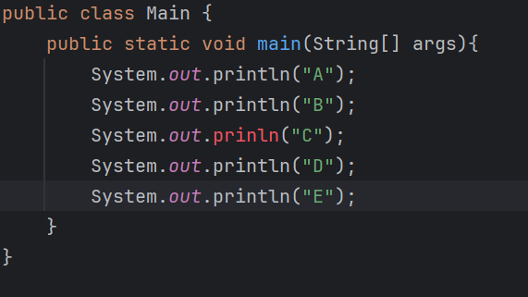
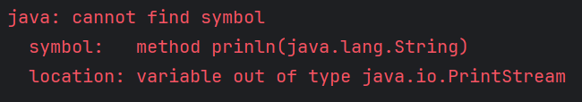
In case compiler finds error
No output at all

Slide 15
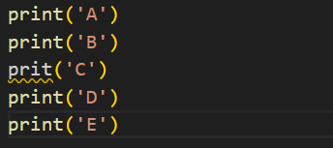
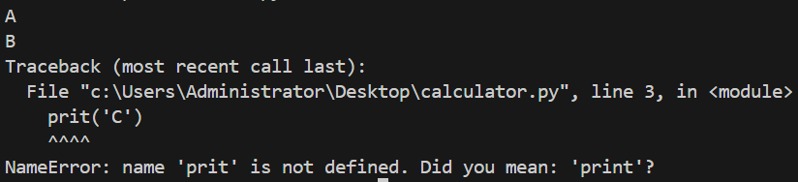
In case interpreter finds error
All outputs before error

Slide 16
Programming Languages
Compiled Languages
Interpreted Languages
C
C++
Java
Rust
Go
Python
JavaScript
Ruby
PHP

Slide 17
Thank you
Zay Min Paing

